Slide 1
How can I show my knowledge of health and wellbeing by describing how to test for, and protect each other from, sexually transmitted infections?
My Body & Me
Sexual health and contraception

Slide 2

Lesson Title
My body and Me
Sexual intercourse, contraception and sexual health
Year 11
This lesson covers:
STIs and common symptoms
forms of contraception
testing for STIs
the importance of communication
forms of treatment
Discussion questions
What is the most effective way to protect ourselves and others from STIs?
Why might some people feel nervous about going for an STI test?
Knowledge
Life Lesson
Using condoms, symptom-checking, testing and communication can prevent the transmission of STIs.
I can protect myself and other from STIs, so infection can be minimised.
Skill focus
British Values
Protected Characteristics
UNCRC
Oracy - Share my thoughts and feelings
Mutual Respect
Individual Liberty
Not covered
Article 24
Notes:
Link to UNCRC RRS: https://docs.google.com/presentation/d/1anz3x3GRbsmSXH5h7je4kqCbcbzhXr671f92BzBwe7w/edit?slide=id.g32c749522eb_0_15#slide=id.g32c749522eb_0_15

Slide 3
Lesson specific notes
Year 11
This lesson covers some topics that people might find upsetting, such as:
  infections
  vaccinations
  risky sexual behaviour
Signposting to support and advice for these topics can be found near the end of this lesson.
If any safeguarding concerns are raised during the lesson, please follow your policy and speak to your Designated Safeguarding Lead.
This lesson includes information around medical testing, vaccinations and STIs. The lesson does not contain any images of needles, but pupils may feel uncomfortable talking about them.
This lesson is designed to reduce stigma around STI testing and treatment. Ensure conversations around going for STI tests are respectful so pupils feel empowered to take control of their own health and wellbeing.
There is a poster activity on slide 32 where pupils are asked to make a poster about one element they have looked at today i.e symptoms, testing, protection or treatment
Localisation
Slide 21: local clinics or pop ups
Slide 36: staff members at school

Slide 4

How can we test for, and protect each other from, STIs?
Date
Do Now
Look at the following statements and decide if they are myths or facts.
You can always tell if someone has an STI.
Condoms protect against most STIs.
Young people are one of the highest-risk groups for STIs.
If you trust your partner, protection isn’t needed.

Slide 5

Do now - Possible answers
You can always tell if someone has an STI.
Condoms protect against most STIs.
Young people are one of the highest-risk groups for STIs.
If you trust your partner, protection isn’t needed.
myth
fact
fact
myth
Do any of these surprise you? Why?
Reflect

Slide 6








Lesson ground rules
Listen to others without interrupting
Be open and honest
Respect each others ideas and opinions
Encourage and support everyone
Think carefully before sharing anything personal about yourself
Don’t ask personal questions to students or staff
Don’t share anything personal about other people

Slide 7


How can we test for, and protect each other from, STIs?
Knowledge
Using condoms, symptom-checking, testing and communication can prevent the transmission of STIs.
Life Lesson
I can protect myself and other from STIs, so infection can be minimised.
British values
Mutual respect
Individual freedom

Slide 8


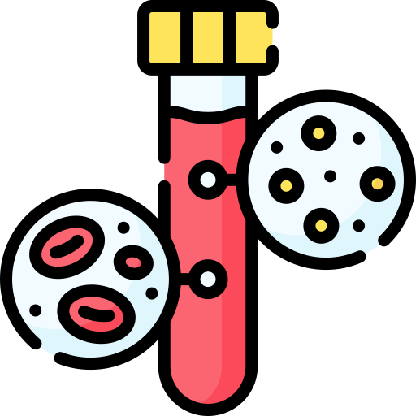

Key terms
STI
contraception
testing
communication
a sexually transmitted infection
something used to prevent pregnancy or the spread of STIs
a diagnostic process using blood, urine, or swab samples to detect infections
open and honest exchange of information

Slide 9
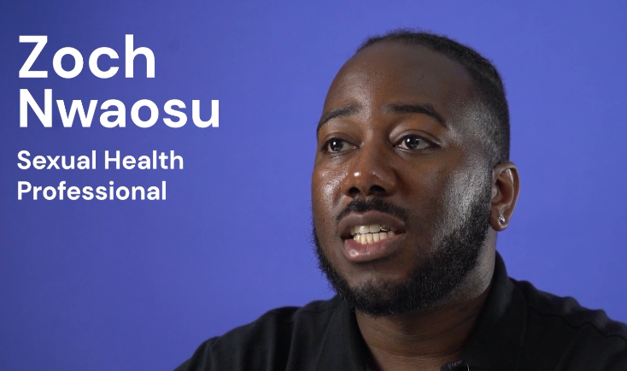


Video
STIs - What are they? How do you get them? How can you protect yourself?
Listen out for
what are the most common STIs for young people?
how STIs are spread
the consequences of leaving them untreated
Video link: https://vimeo.com/751765972/d17b4a17cd

Slide 10

Video summary
The most common sexually transmitted infections amongst young people are chlamydia and gonorrhea.
STIs can spread through penetrative, or oral sex, they can also be spread by the sharing of sex toys, mutual masturbation, or anywhere where there is an exchange of bodily fluids.
The consequences of having an STI which is left untreated can be - infertility, and also experience of pain and discomfort.

Slide 11


STIs
A
Sexually transmitted infections are spread by skin-to-skin contact or contact with bodily fluids.
Common STIs in the UK include:
Gonorrhea
Chlamydia
Herpes
Genital warts
Syphilis
HIV & AIDs
What is the most effective way to protect ourselves and other people from STIs?
Discuss

Slide 12
Possible answers
A
What is the most effective way to protect ourselves and other people from STIs?
barrier contraception e.g male condoms, female condoms
getting tested regularly
HPV vaccination
communication with current or ex partners if someone diagnosed with STI
avoiding any sex or sexual contact if symptoms appear or after positive test
choosing to not have sex

Slide 13
STI symptoms
Symptoms include:
pain when peeing
unusual discharge from the vagina, penis or anus
unusual vaginal bleeding
warts in the mouth or throat (rare)
itchy genitals or anus
lumps, blisters, sores or warts around the genitals or anus
HIV/AIDS has symptoms similar to the flu, so requires a blood test

Slide 14


Penetrative sex
Condoms the easiest ways to prevent infection between a penis and a vagina/anus.
STIs can be passed through bodily fluids, via:
fingers
sex toys
genitals
anus
mouth
Cleaning these areas with warm water and soap if they contact the genitals, mouth or anus protects against infection.

Slide 15
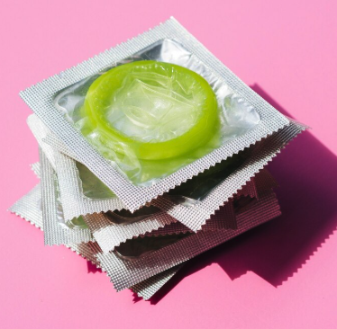
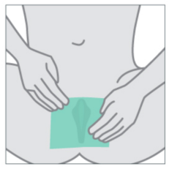
Oral sex
Oral sex is any sexual act involving the mouth.
A dental dam is a thin, flexible, square sheet of latex, used as a protective barrier during oral-vaginal or oral-anal sex.
Flavoured condoms can prevent contact between the mouth and a penis during oral sex.

Slide 16


Activity
1
Read the scenario and challenge the misconceptions.
I have heard that the only way to pass an STI is through penetrative sex, and that oral or anal sex is super low risk.
Also, I am pretty sure oral contraception doesn’t even exit, because what would be the point?
I read online that using sex toys with a partner removes the risk of spreading STIs because there is no physical spreading of bodily fluids.

Slide 17
Activity - possible answers
1
STIs are spread through the exchanging of bodily fluids, this can happen during any sexual act - not just penetrative sex
oral sex is one way that partners can exchange bodily fluids, and therefore can risk the spread of STIs
dental dams and flavoured condoms are contraception which is used during oral sex
sharing sex toys can spread bodily fluids, especially if they are used by both partners and used with different parts of the body. To avoid this, sex toys should be cleaned with warm water and soap before being shared, or used for different sex acts

Slide 18

Quick think
Is this statement true or false?
30
sec
If someone has an STI you would know straight away because the symptoms would be visible to you.
False - most STIs are asymptomatic at first (meaning there are no visible or tangible symptoms).

Slide 19

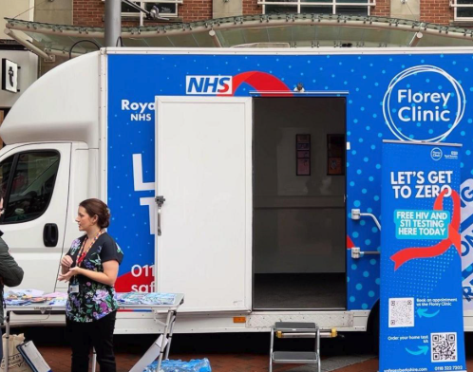
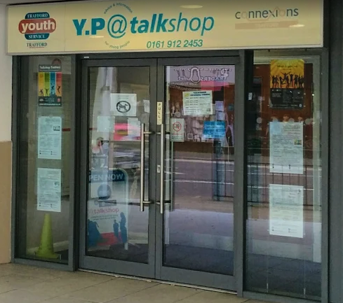
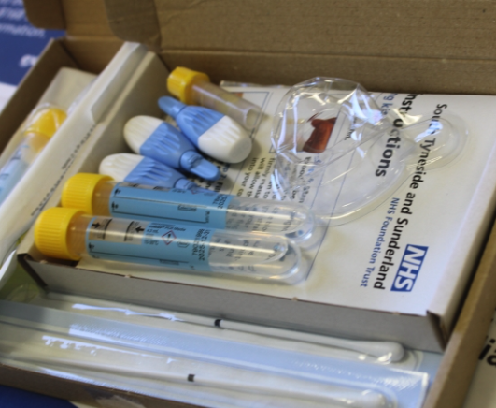
Testing
The easiest way to access STI testing is to contact local sexual health clinics or services in your area, such as:
sexual health centres
testing pop-ups in town centres
youth-specific sexual health clinics and services
at home tests that patients post to clinics

Slide 20


Slide 21
Halfway activity
2
Can you try to link the STI to the type of test used to detect it?
Chlamydia/ Gonorrhoea
blood test, or swab of sores/ulcers
HIV or AIDs
urine sample, or vaginal swab, or throat swab
HPV
blood test, or saliva sample
Syphilis
cervical swab (smear test)

Slide 22
Activity possible answers
2
Can you try to link the STI to the type of test used to detect it?
Chlamydia/ Gonorrhoea
blood test, or swab of sores/ulcers
HIV or AIDs
urine sample, or vaginal swab, or throat swab
HPV
blood test, or saliva sample
Syphilis
cervical swab (smear test)

Slide 23
B
Why might some people feel nervous about going for an STI test?

Slide 24
Possible answers
B
Why might some people feel nervous about going for an STI test?
embarrassment or shame
worry about blood / needles
nervous about tests on intimate body parts
scared about the result
worry about having to tell partners about results
concerned about judgement from medical staff, or others also in the clinic
having to answer questions about sexual partners or activities
not knowing what will happen

Slide 25

Fears
Feeling nervous about an STI is typical, but the process exists to help you and should be supportive.
I felt so nervous going to my local clinic to have my first STI test. I felt like I’d be judged by the nurses and others in there, and I was so scared I’d see people there that I recognised.
I was reassured by a friend who had had one before, who reminded me anyone in there has gone to protect themselves and others, which is really positive. The test itself was quick, and didn’t hurt at all. The nurse who did the test explained everything and made me feel really at ease. They said they would be in touch with the results and assured me that, whatever the result, there would be support.

Slide 26
Quick think
You have 2 minutes to fill in the blanks using the word bank below.
2
min
If someone gets symptoms of an _____, or receives a _______ test result (showing that they have an infection), it is important to _________ this to current and ______ sexual partners. This can help halt the ______ of STIs.
STI
positive
communicate
former
spread
former communicate spread STI positive

Slide 27

Communication
Communicating with partners about testing and positive results for STIs can feel daunting, but it is important to be open and honest.
After my positive result for Chlamydia, I told my current girlfriend. I was nervous to tell her, but she was thankful I was honest and she has gone for testing and treatment herself. I had to inform former partners, and the NHS offers a free service, where they will message people on your behalf, confidentially, informing them they have come into contact with the STI encouraging them to get tested themselves.
It can be useful to remember that STIs are similar to other infections, and there should be no shame in catching one.

Slide 28
Communication
Healthy sexual activity needs…
communication
contraception
regular testing

Slide 29
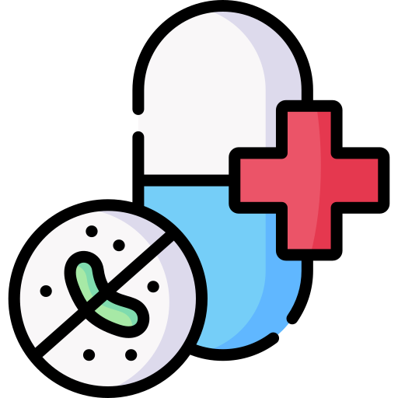

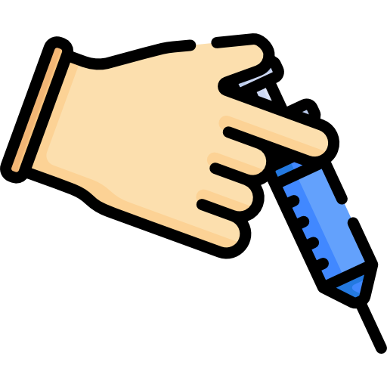
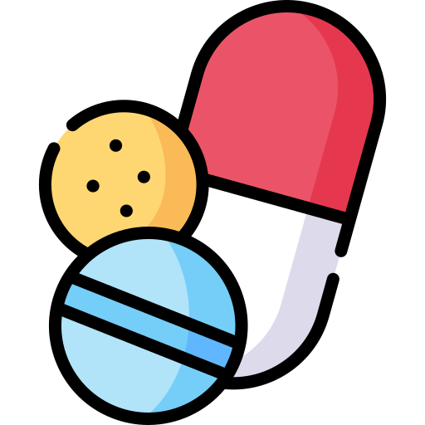
Treatment
Treatment may look different, depending on the STI, but all can be managed or treated.
Common treatments include:
Misinformation around the treatment of STIs is common, and can be scary. You should always seek reputable support e.g the NHS website, or medical professionals.
antibiotics (e.g for Chlamydia)
topical creams (e.g for genital warts)
antibiotic injections (e.g for syphilis)
antiviral tablets (e.g for genital herpes)

Slide 30
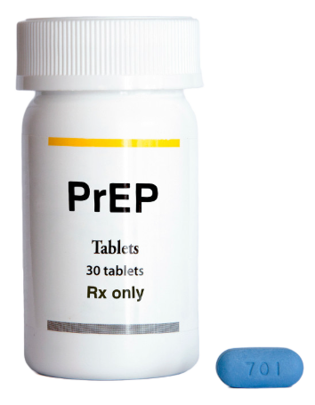

HIV and AIDs
HIV is a deadly virus, that kills hundreds of thousands of people across the world each year. However, there is now an effective treatment, available for free in the UK:
PrEP (Pre-Exposure Prophylaxis) is a pill that prevents someone from being infected by HIV. It can be taken before someone thinks they might have sexual contact with someone else who has HIV.
PeP (Post-Exposure Prophylaxis) is a pill that prevents someone from being infected by HIV. It can be taken after sexual contact with someone who may have HIV.

Slide 31

Activity
3
Create an awareness campaign poster on one element of today’s lesson.
contraception
testing
communication
treatment
where to get support
Each poster should contain:
some key facts on the area you chose
importance of STI prevention
a positive, supportive message to help people overcome fear, shame or worry

Slide 32

Video
How can you talk with your partner about safe sex and contraception?
Listen out for
feeling comfortable
changes over time
communicating with sexual partners
Video link: https://vimeo.com/741931993/e43a3d7235

Slide 33


Video summary
Wren says that if you are having sex with someone, you should feel comfortable to speak about condoms and contraception. If someone feels uncomfortable talking about these things, it might be a sign that they aren’t ready to have sex yet.
Hayden says that contraception choices can change over time, for example, someone may be on the pill and then decide to stop taking it. It’s important to be open and a relationship should be founded on wanting the other person to feel happy and safe.
Do you agree with them?
Why?
Discuss

Slide 34

Reflect
Which statement is accurate?
condoms are the only contraceptive to stop STIs
testing for STIs is humiliating
open communication between partners can prevent the spread of STIs
HIV or AIDs is untreatable

Slide 35
HPV is a common infection*, which is normally asymptomatic (no symptoms).
Why do you think many people choose to tell their sexual partners if they know they have HPV?
*80% of people get it at some point in their lives

Slide 36
Possible answers
HPV is a common infection, which is normally asymptomatic (no symptoms).
Why do you think many people choose to tell their sexual partners if they know they have HPV?
Although HPV is common, it can increase the risk of health issues, including cervical cancer.
Awareness of HPV infection risk can help people to make decisions around testing.

Slide 37



Where to get support
Advice and information on contraception and sexual health clinics.
Free & confidential sexual health & wellbeing experts
We're here for you, whatever's on your mind. We'll support you. Guide you. Help you make decisions that are right for you.
Find out more on the NHS website
Find out more on the Brook website
Find out more on the Childline website

Slide 38
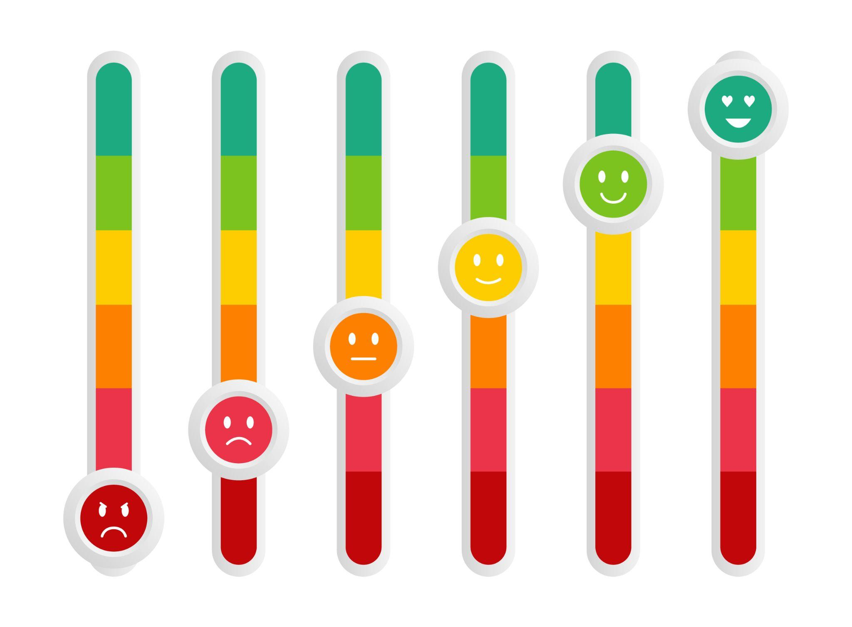
How confident do you feel about this topic?

Slide 39




Feedback
We regularly update our lessons, to make sure that our resources remain relevant, appropriate and engaging for young people.
If you’d like to let us know what you think, please complete this form. It takes as little as 30 seconds and you only have to answer the questions that are relevant to you.

Slide 40
Life Lessons supports teachers to deliver outstanding relationships, sex and health education.
We aspire to a world where all young people are equipped to be healthy, make good decisions and navigate the social and emotional complexities of life.
Discover our approach to learning

