Slide 1
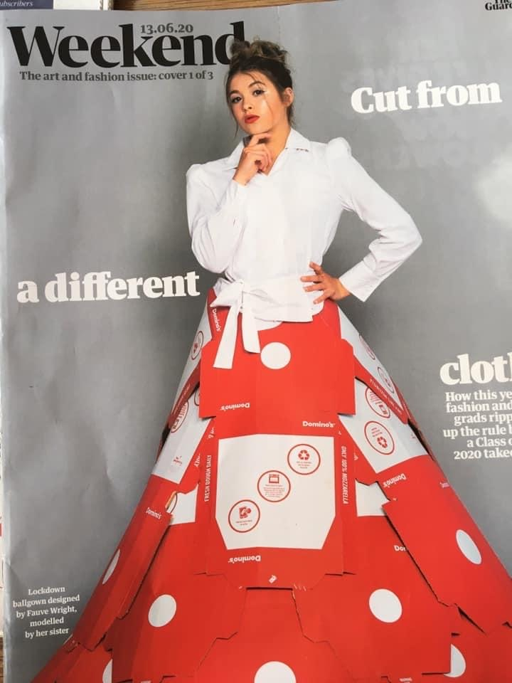
Trashion Fashion Competition:
Objective: Using the images as inspiration, wash and save a weeks worth of recycling and create a garment of your choice.
Consider:
How you will attach the materials (tape and glue doesn’t want to be seen – can you use heat or staples?)
Someone will need to be your model? Can they get it on and off?
Can you manipulate the materials in an interesting way (crease, origami, cut into circles, make the materials 3D?)
Take a picture of you or a family member wearing it and email to Miss Neal: cneal@prioryacademies.co.uk
Deadline: Friday 10th July
House points for all entries and prizes for the most creative!!

Slide 2
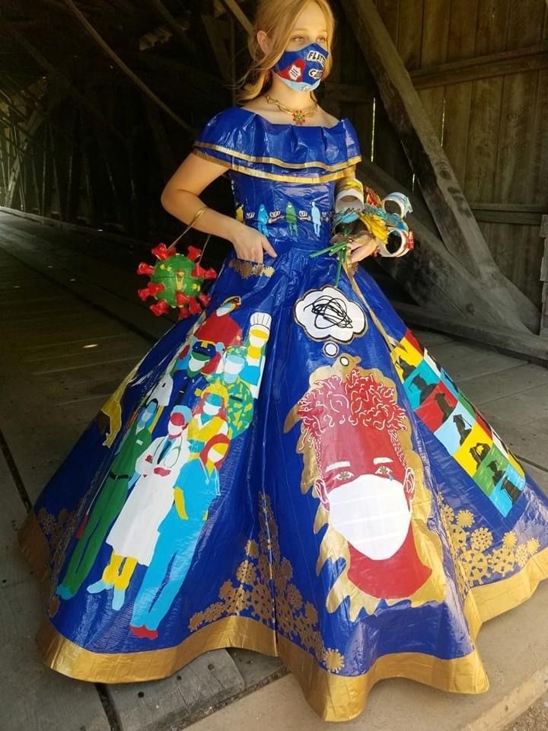
Corona Virus inspired Prom dress made from coloured duct tape only.
Wow! Look at all the images this girl has created on the skirt
I love her corona virus shaped clutch bag in particular
Can coloured electrical tape/duct tape help you join your materials or make imagery/surface pattern somehow??

Slide 3
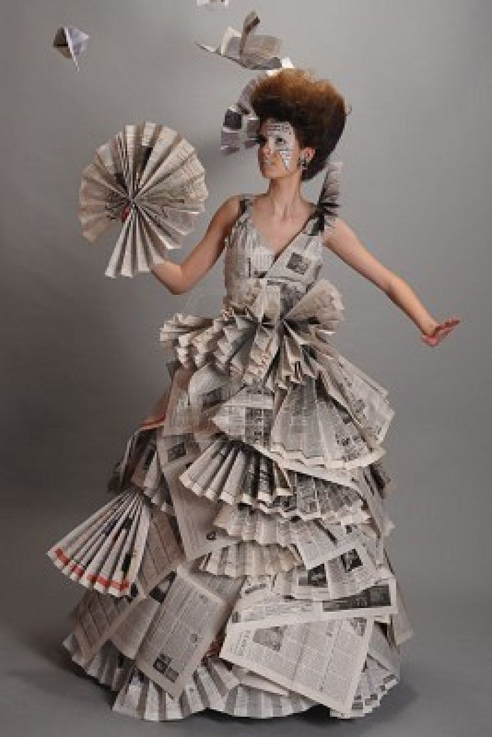
Folded Newspaper Gown
Newspaper is very versatile and strong when folded or rolled. It can also be neatly and easily joined using staples (just make sure the backs of the staples are on outside so you don’t stab your model)
Can you fold sheets of newspaper, junk mail, magazine, old posters or wall paper in interesting ways to create pleats or layers?

Slide 4
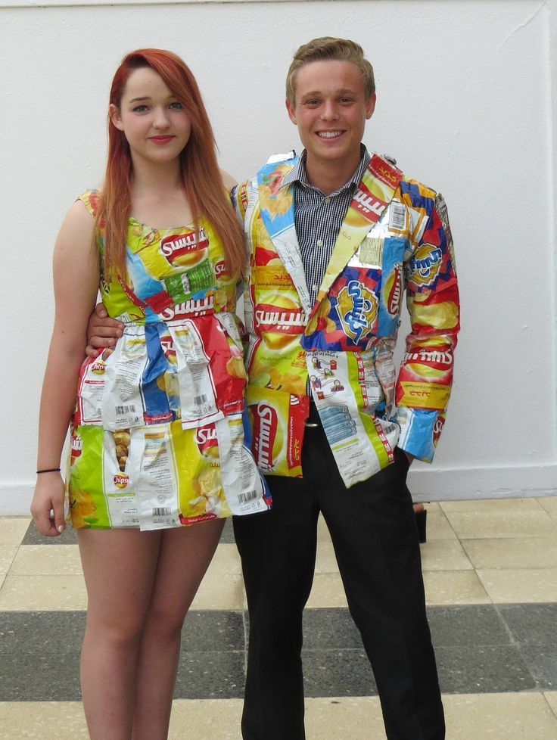
Crisp Packet Formal Wear
Not only do crisp packets come in so many sizes, designs and colours – they can also be manipulated by heat… (how many of you fold them into tiny triangles? Try heating them for a few minutes in the oven? Iron them together between greaseproof paper)
Can someone make me a crisp packet jacket? I would wear that!

Slide 5
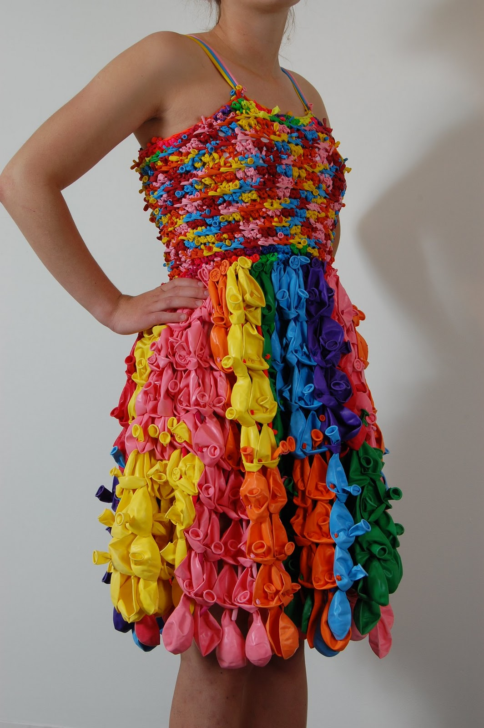
Party Frock
I bet you have never seen balloons used like this?
(have you had a lockdown birthday party – did you save the banners or have leftover balloons?)
They can be inflated, stretched, cut into strips, plaited or knotted!
Strips of bin bags could also be knitted, knotted, crocheted or woven to create a garment!

